Slide 1


Christopher Columbus Adventure
Presented By: Lavanya Neela Navya Sree

Slide 2

Abstract
Christopher Columbus Adventure is a client-server based game where players navigate Columbus across a dynamically generated ocean grid, avoiding pirate ships and sea monsters to discover hidden treasure. Built using Java and React.js, this project demonstrates modular design, application of design patterns, and real-time interaction through REST APIs.

Slide 3
Software Requirements
Functional Requirements:
Dynamic larger ocean grid support
Treasure searching and win condition
Smarter pirate movement strategies
Non Functional Requirements :
Clear client-server separation
Modular and scalable multi-class design
Correct usage of 5 design patterns

Slide 4


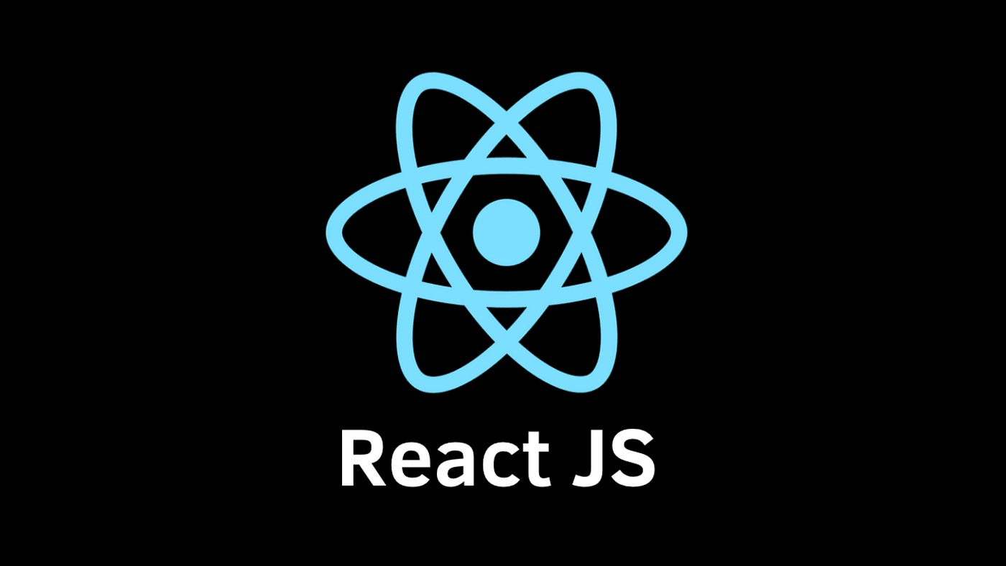


FRONTend and backend tools
FrontEnd :
BackEnd:

Slide 5
Improved Architecture (Industrial Standard
Frontend Layer
(React.js, TypeScript - Client UI)
API Gateway Layer
(NanoHTTPD Server - REST APIs)
Application Layer
(GameServer, GameState Controllers)
Service/Logic Layer
(Pirate, Sea Monster Strategies)
Data Layer (Model)
(OceanGrid, Ship Positions)

Slide 6
Design patterns
1)Singleton Pattern
2)Observer Pattern
3)Factory Method
4)Strategy Pattern
5)Decorator Pattern
6)Composite Pattern

Slide 7
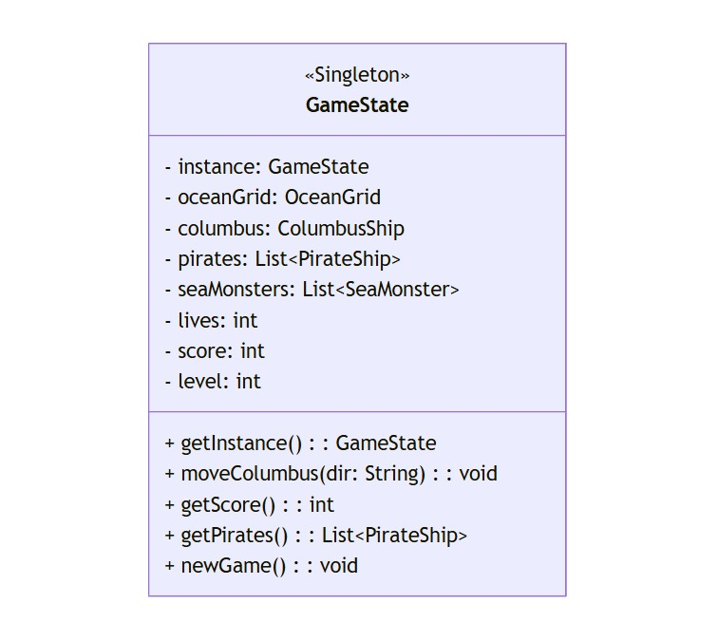
UML: Singleton pattern

Slide 8
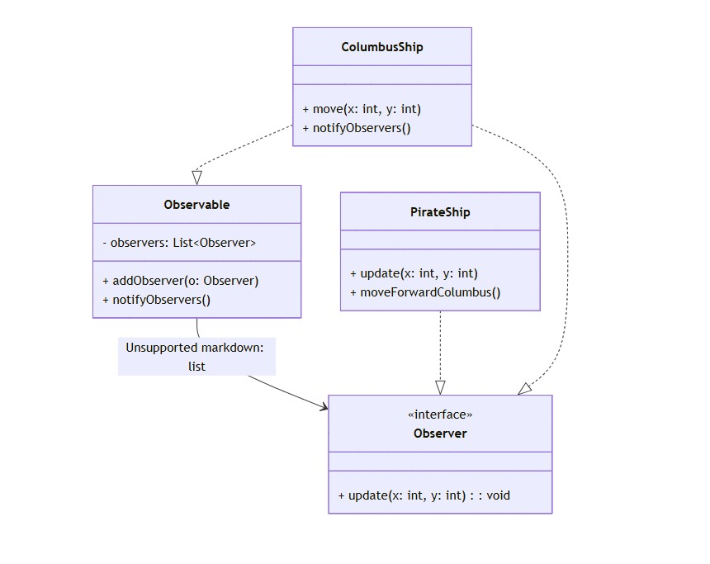
UML:Observer pattern

Slide 9
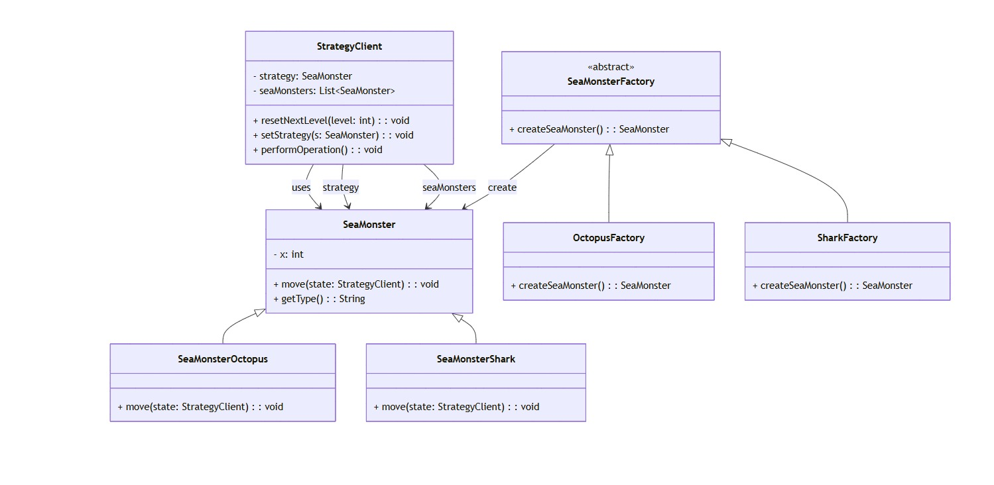
UML: Factory method

Slide 10
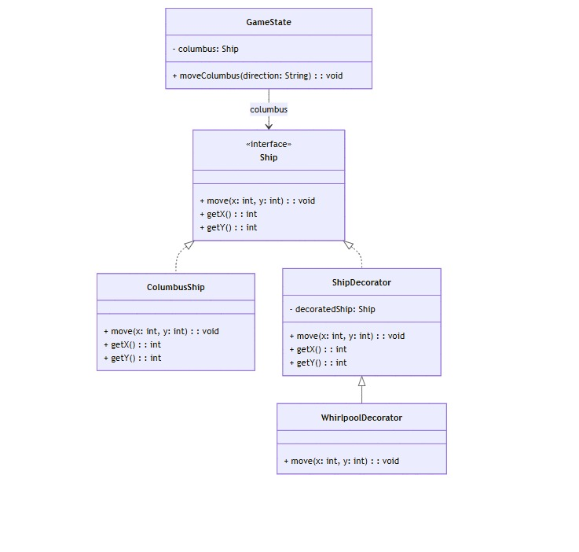
UML: Decorator pattern

Slide 11
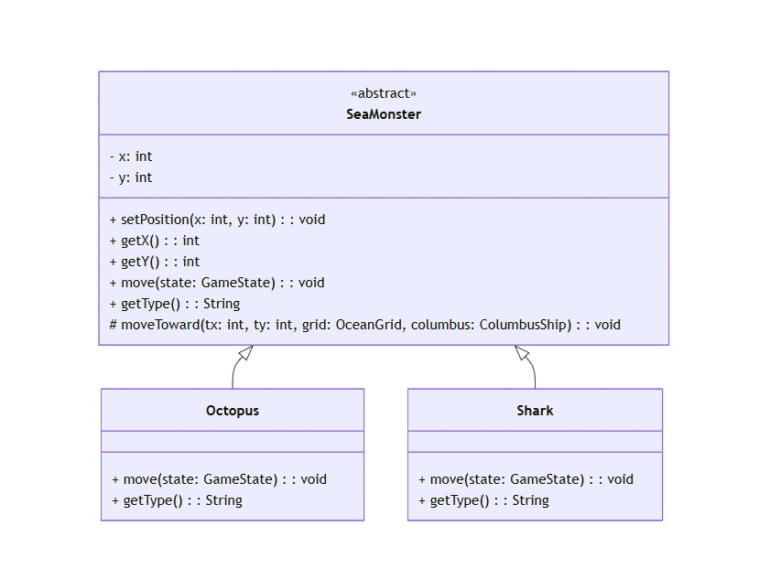
UML: STRategy pattern

Slide 12
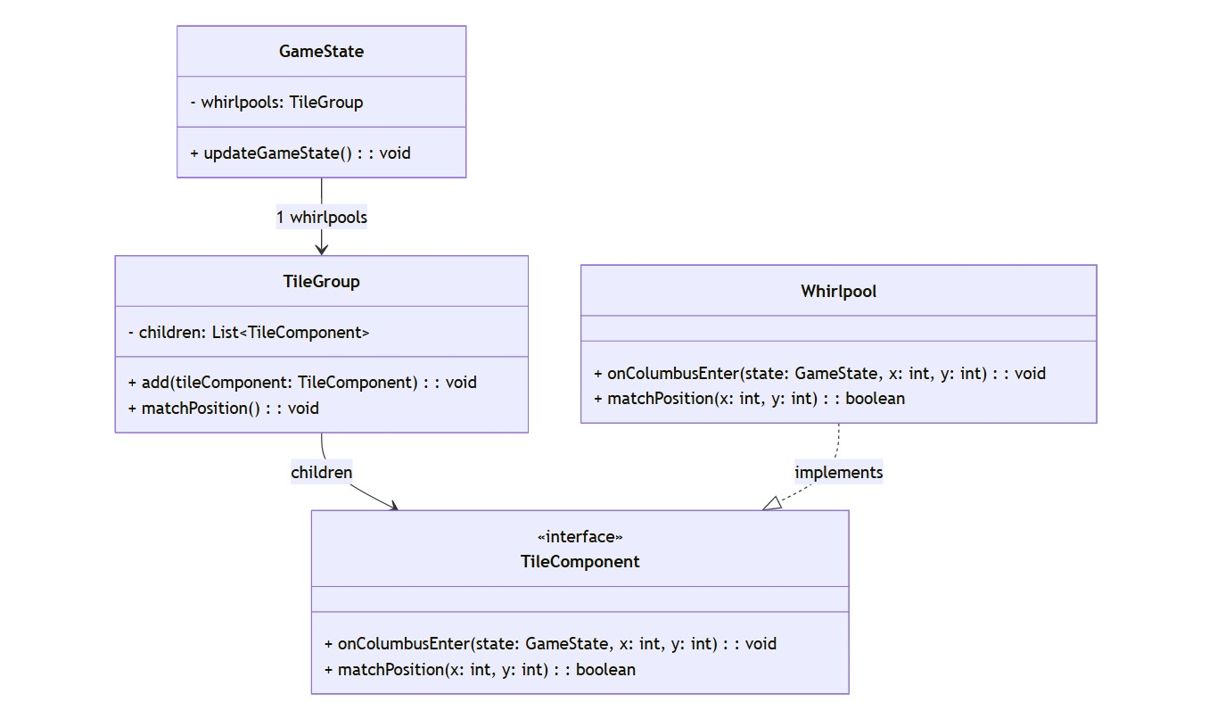
Uml: Composite Pattern

Slide 13
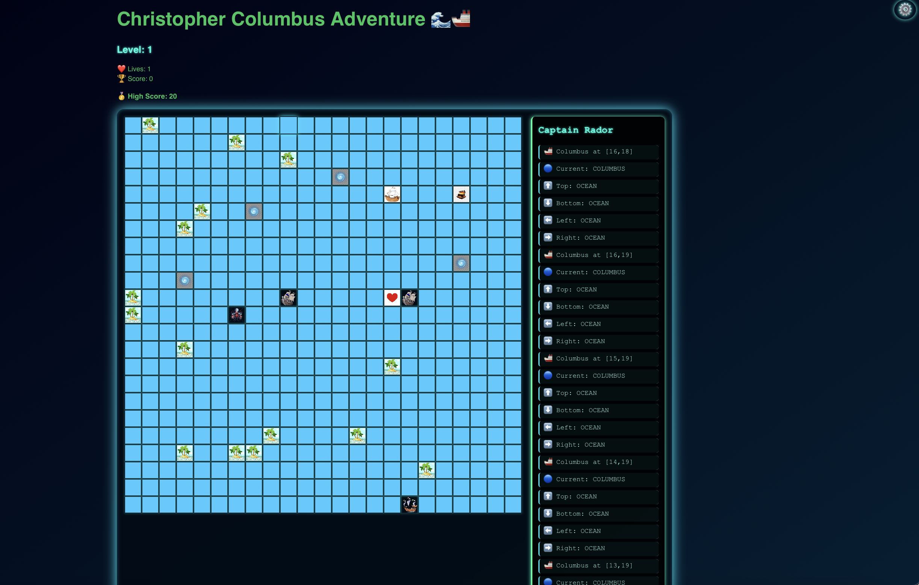
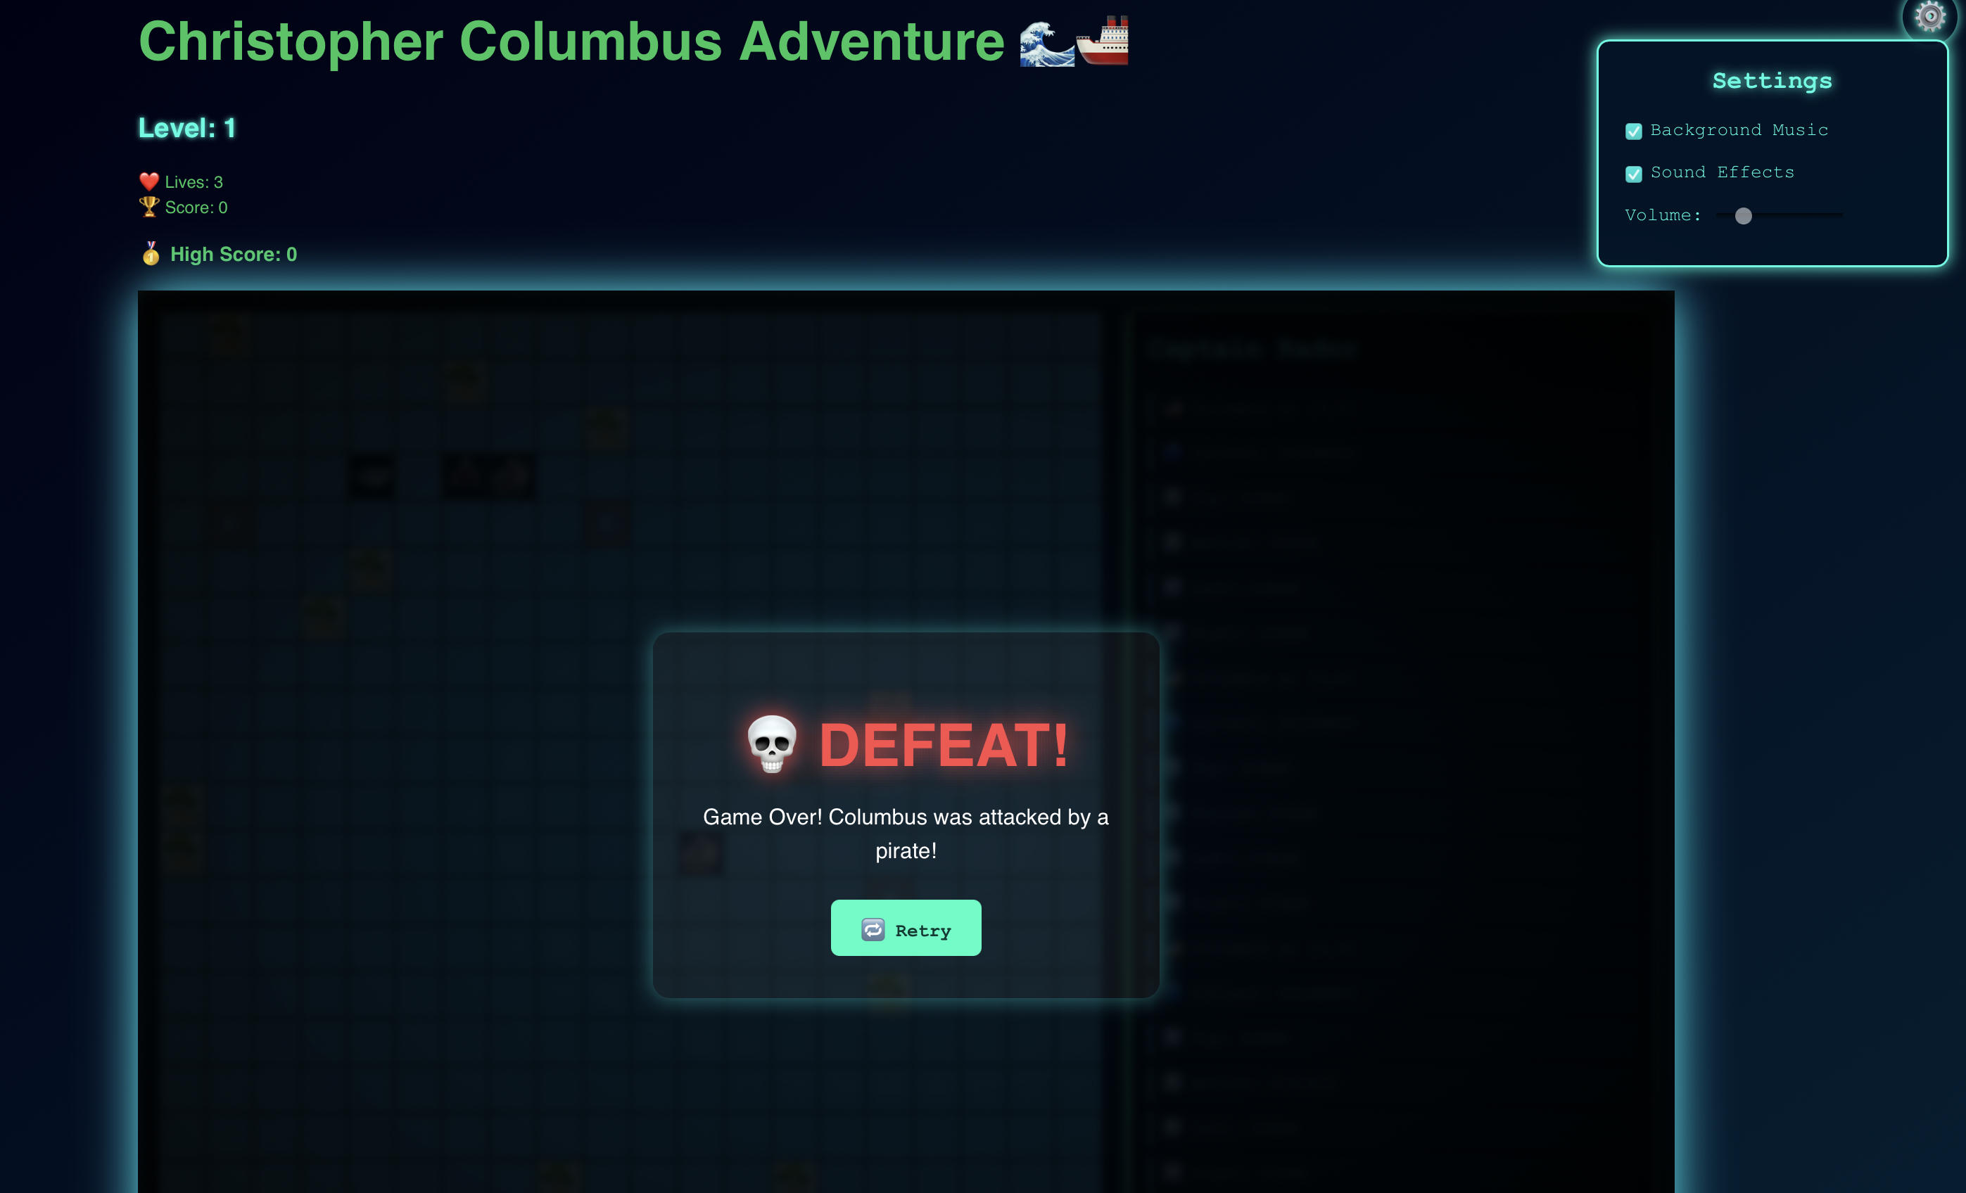
Outputs and videos

Slide 14
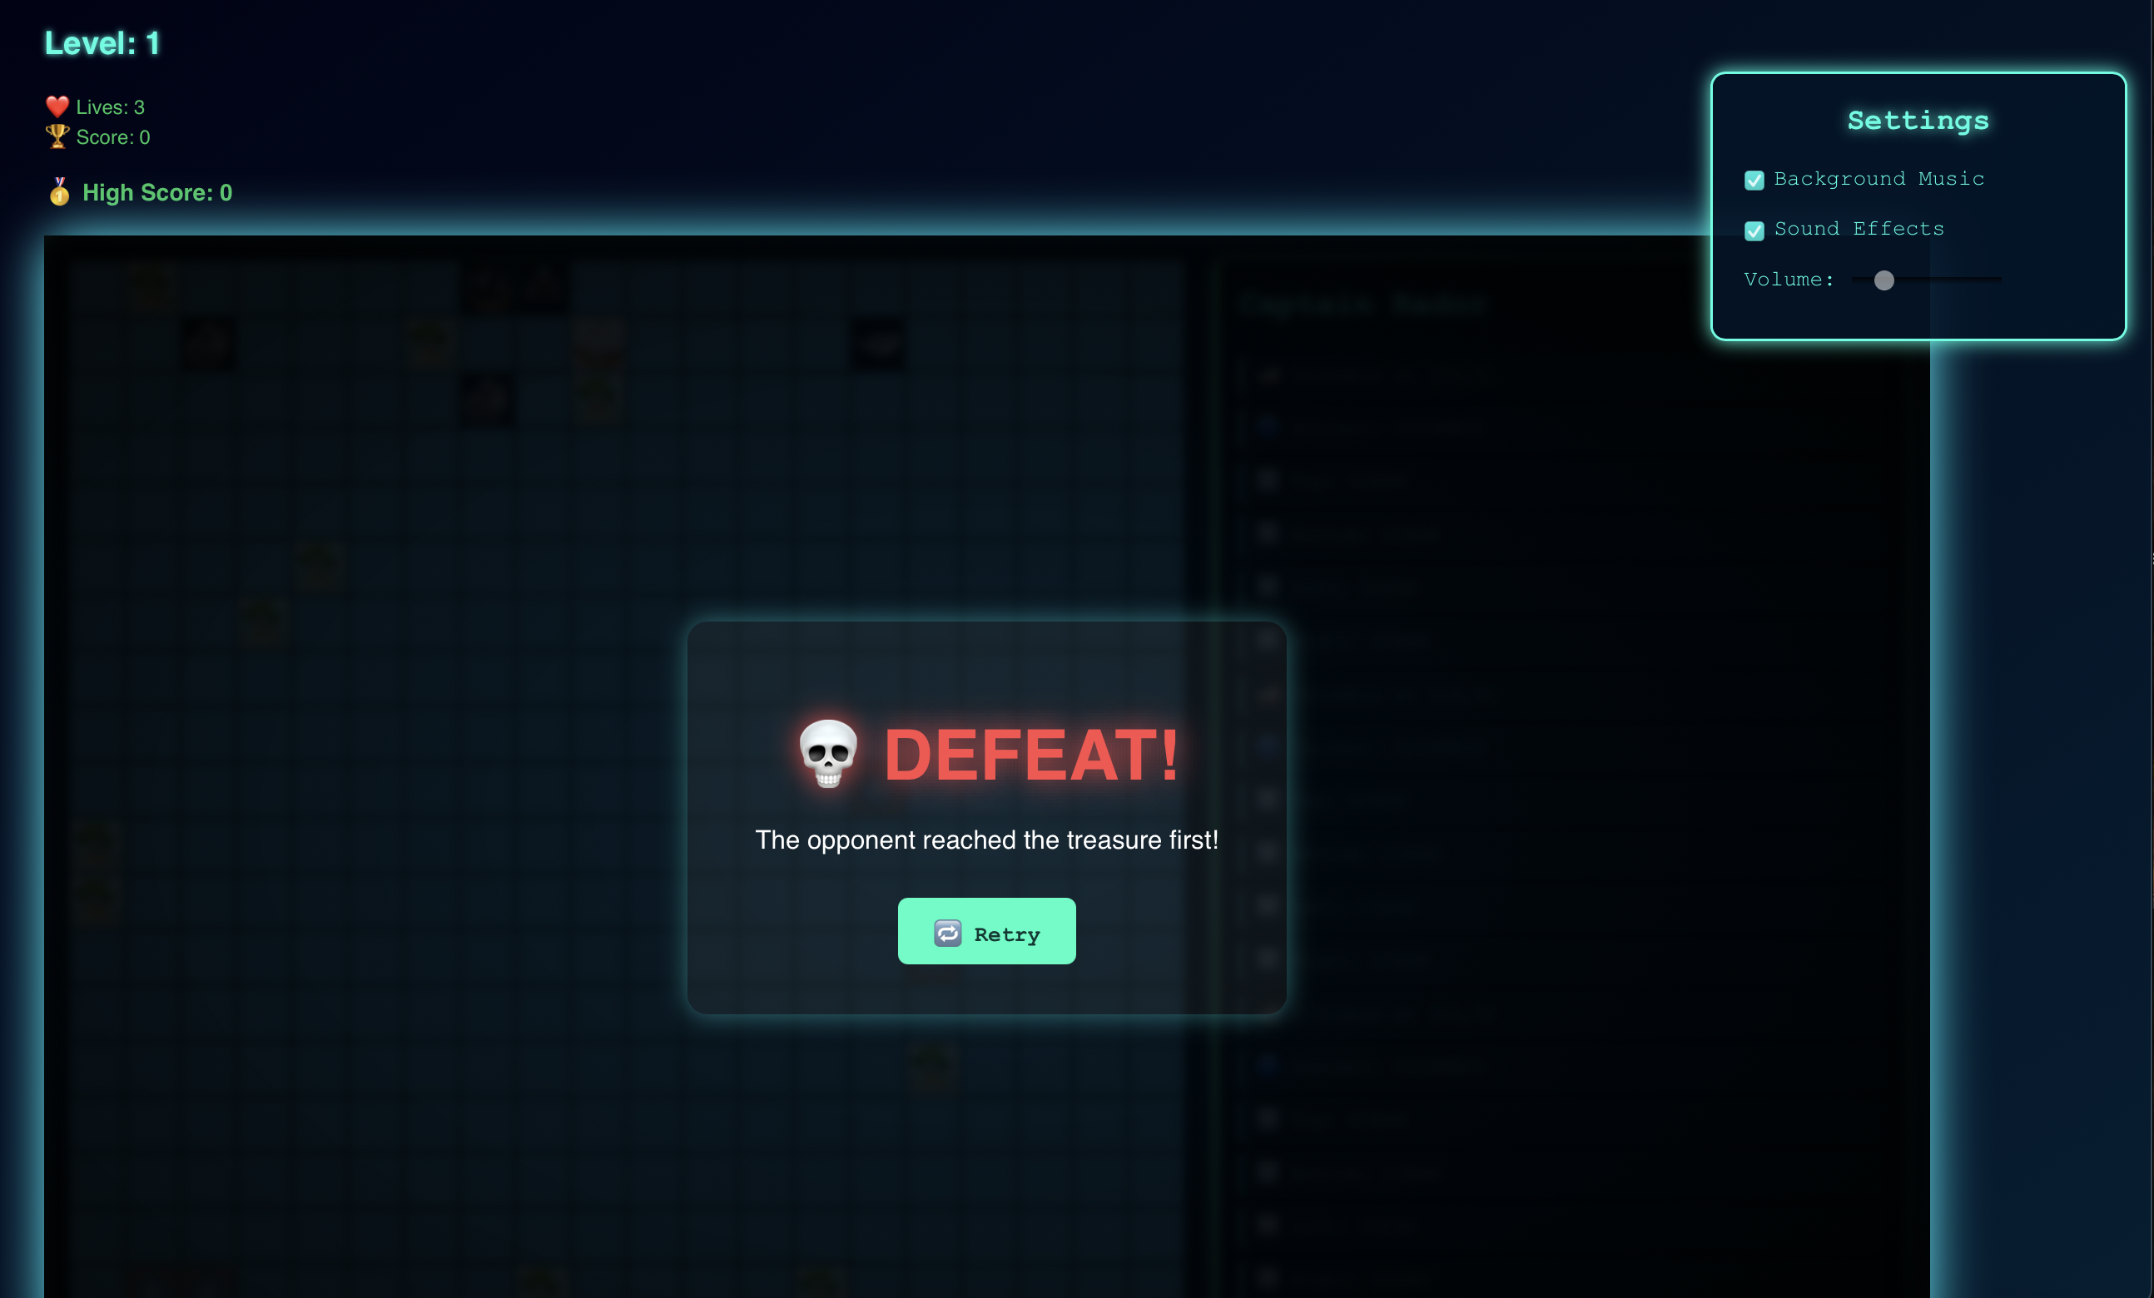
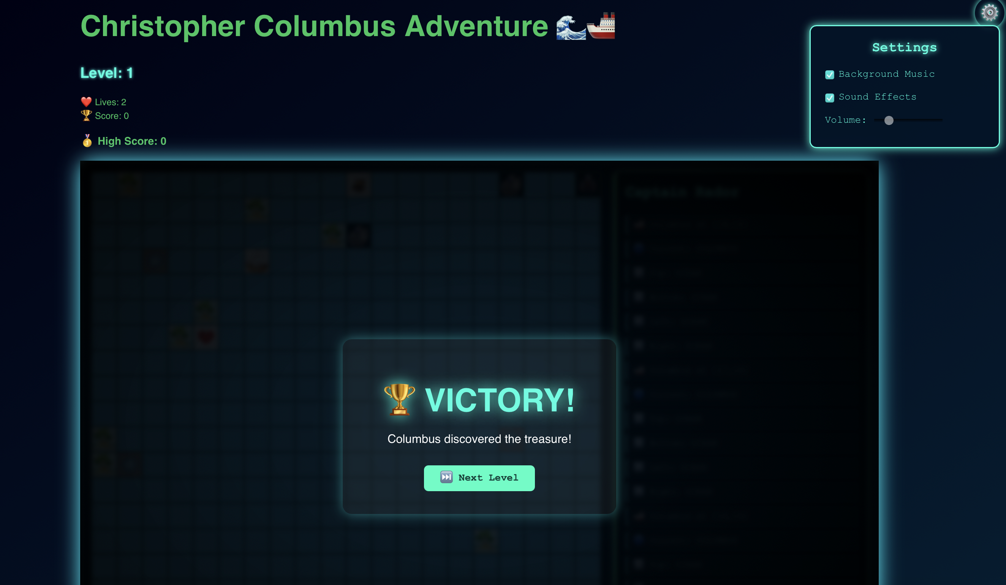
Outputs and videos

Slide 15
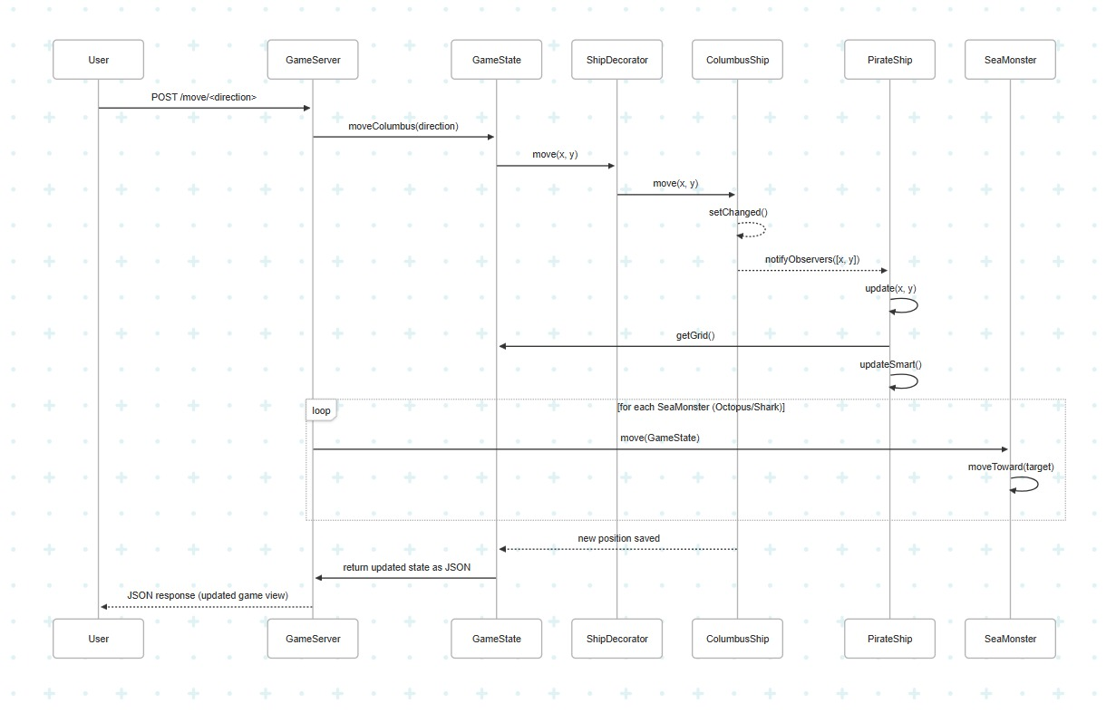
Sequence diagram

Slide 16
Conclusion and q&A
The Columbus Game backend showcases effective use of object-oriented design patterns to achieve a modular and maintainable architecture. Key patterns like Strategy, Observer, Factory, Singleton, and Composite are integrated to minimize coupling and improve extensibility. For example, the Observer pattern allows PirateShips to respond to ColumbusShip movements without direct dependency, while the Factory pattern simplifies the creation of different monster types. Centralizing game logic in a Singleton GameState enables consistent state management across the game. These patterns collectively support scalability, easy feature additions, and a clean separation of concerns—making the system robust and adaptable.

Slide 17


